Slide 1
Are we alone in the universe?

Slide 2
Learning Objectives
To describe some of the methods used to search for extra-terrestrial life.
To understand the individual factors contained in the Drake Equation and appreciate their uncertainties.
To describe the existence of habitable (‘Goldilocks’) zones around stars.
To contemplate and discuss the benefits and dangers of discovering life elsewhere in the Universe.

Slide 3
What methods do scientists use?
Scientists agree that if life (past or present) is to be found elsewhere in the Solar System that it will likely be carbon based and have required water to form and survive.
It is unlikely that life exists in the human or animal forms we’re familiar with, due to a lack of breathable oxygen or an appropriate position in the Solar System. Instead scientists think life could be microscopic or algae, or dependent on hydrothermal vents on an ocean floor similar to those found in the deepest parts of Earth’s oceans, so that they do not depend on the Sun. There may be life that depends on nitrogen or methane instead of oxygen.
Scientists have focused on terrestrial planets and moons in their search for life although some theories exists about life floating in the clouds of Jupiter and Venus that depend on thin clouds of water there.

Slide 4
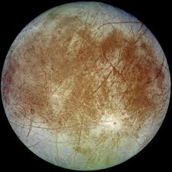
The Satellites of Jupiter and Saturn
Europa is considered to have a large underground ocean, as are Ganymede, Callisto (Jupiter Satellites), and Enceladus (Saturn). Enceladus spews geysers of water into space from its south polar region.
Until scientists are able to understand the structure of these bodies and make observations nearer to them, observing or detecting signs if life underneath rock and icy surfaces will be difficult.

Slide 5
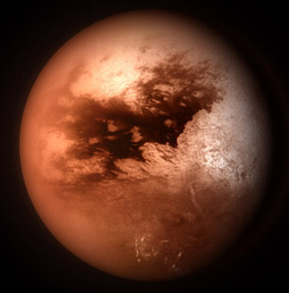
Titan
Titan (satellite of Saturn) possesses large lakes of methane. Until further exploration of the moon and understanding of its chemistry is found, it is unlikely to yield proof of past or present life.

Slide 6
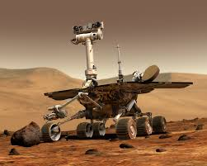
Mars
Mars is a popular subject for speculation about life. A large ocean covers parts of the planet and there is recent evidence of some liquid flows on the surface.
Probes and artificial satellites scan the planet looking for signs of underground activity. Probes sent have found water in soil samples (Phoenix Mission).
The Viking Lander experiments that attempted to find evidence of microbes in the surface in the 1970s were inconclusive.
A meteorite fragment found in Antarctica caused headlines in the 1990s. It came from an impact on Mars and found its way to Earth. Bacteria-like structures were found in the rock but the results are inconclusive and controversial TOAST

Slide 7
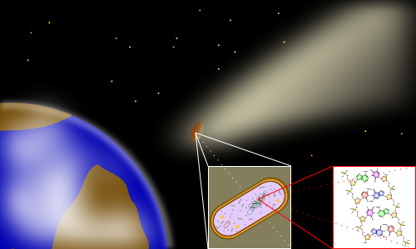
Astrobiology???
Some Astrobiologists believe that life may spread between planets or moons by comets or asteroids – a process called ‘panspermia’.

Slide 8
The Drake Equation
The Drake Equation was proposed by Dr Frank Drake in 1960 as a model for scientists to estimate the probability of life elsewhere in the galaxy and life that is intelligent and can be contacted.
N is the number of civilizations in our galaxy with which communication might be possible;
R* is the average rate of star formation in our galaxy
fp is the fraction of those stars that have planets
ne is the average number of planets that can potentially support life per star that has planets
fℓ is the fraction of the above that actually go on to develop life at some point
fi is the fraction of the above that actually go on to develop intelligent life
fc is the fraction of civilizations that develop a technology that releases detectable signs of their existence into space
L is the length of time such civilizations release detectable signals into space.

Slide 9
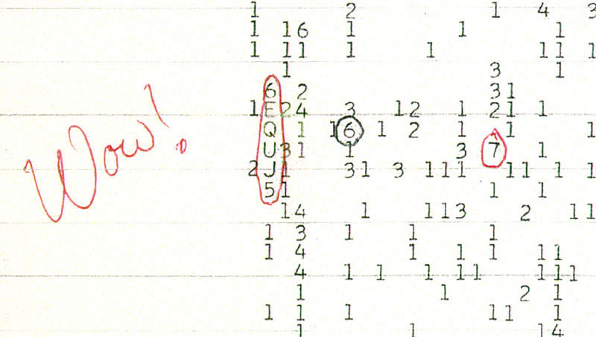

Slide 10
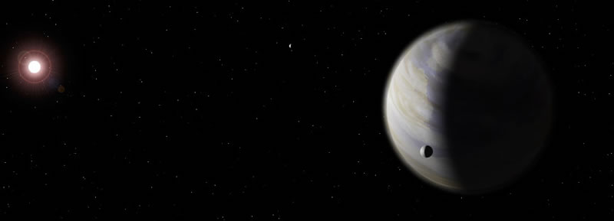
The Goldilocks Zone
The Habitable zone is an area surrounding a star in which a planet can have liquid water at its surface. If water is present, life could be too. It is sometimes known as the Goldilocks zone as it is not too hot and not too cold.
In our Solar System it is thought the zone extends from outside the orbit of Venus to halfway through the asteroid belt (0.75 to 3AU).
This region is also known as the CHZ (Circumstellar Habitable Zone).

Slide 11
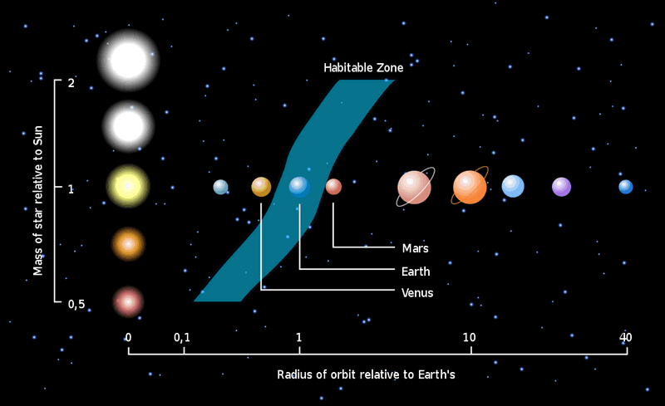

Slide 12
Apply Your Knowledge
The drake equation looks very complicated, and will make a lovely display ☺
Try to make a poster including the drake equation, what it shows and what each component stands for.

