Slide 1
Birth of Stars

Slide 2
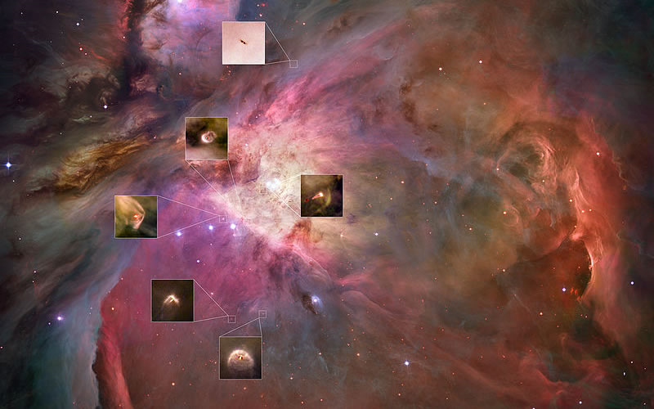
Prepare to learn
What does this picture show?

Slide 3
Lesson Objectives
To associate the stages in the birth of stars with emission and absorption nebulae.
To show an awareness of the main components of the HR diagram and relate these to stellar birth

Slide 4
Prepare to learn
Watch the clip about the birth and death of a star. Make appropriate notes.

Slide 5
The life cycle of a star
The lifecycle of stars

Slide 6
Construct your Knowledge
In your books produce a timeline of the life cycle of a star. Do 3 different outcomes for main sequence, giant and super giant stars.

Slide 7
Types of Nebula

Slide 8
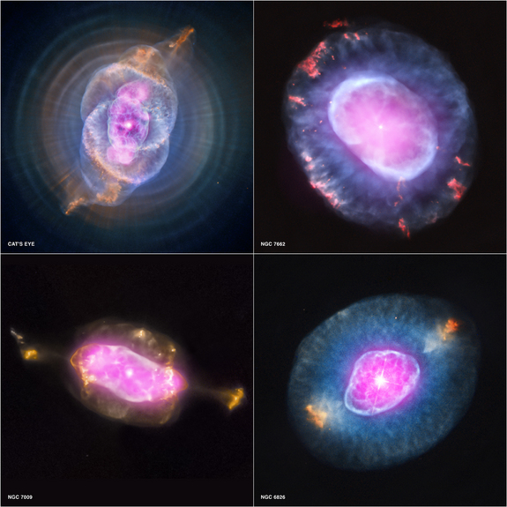
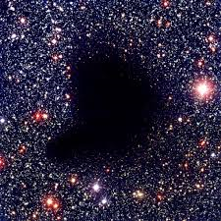
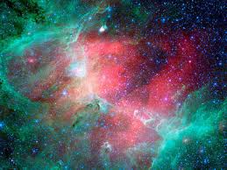
Review
Which nebula is which? Why?
B
C
A

