Slide 1
Classification of Galaxies

Slide 2
Learning Objectives
To be able to classify galaxies (including our own) according to their appearance.
To be able to draw Hubble’s ‘Tuning Fork’ diagram.

Slide 3
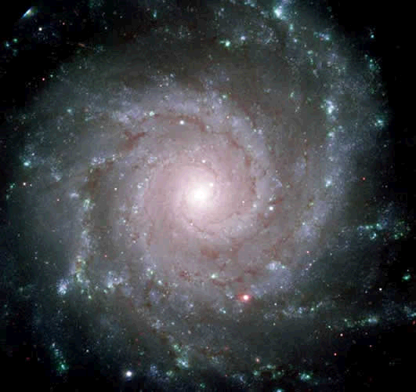
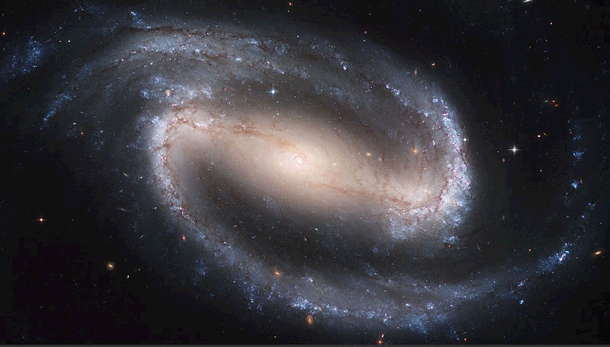
Spiral and Barred Galaxies
1. Spiral Galaxies. The spirals arms wind around the nucleus.
2. Spiral Barred (or Barred Spiral) The spirals extend from a bar through the nucleus.
Typically older stars are nearer the nucleus while younger stars are further out in the spiral arms.

Slide 4
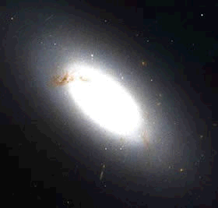
Elliptical Galaxies
These come in a general ellipse shape. Some are spherical, some are cigar shaped. Typically they are brighter towards the centre.

Slide 5
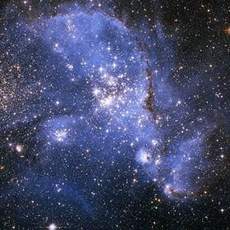
Irregular Galaxy

Slide 6
Irregular Galaxies
Irregular galaxies do not fit into the tuning fork diagram and usually bear no relation to the shapes of other galaxies or have any obvious symmetry. Their strange shape may have arisen because of disturbances from other galaxies.
An example of an irregular galaxy is the Small Magellanic Cloud in Tucana.

Slide 7
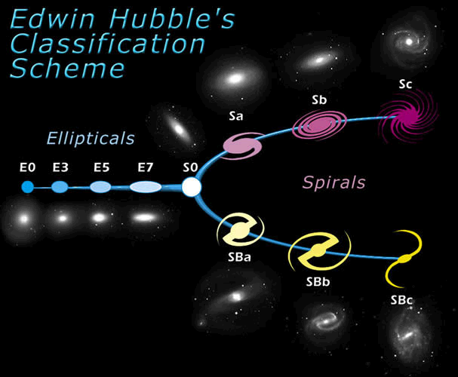
Hubbles Tuning Fork Diagram

Slide 8
Hubbles Tuning Fork Diagram
Edwin Hubble classified galaxies according to their shape. He produced a tuning fork diagram as he thought this demonstrated the evolution of elliptical galaxies into spirals.
This theory is considered to be incorrect but astronomers still use the diagram and his classification to judge what category a galaxy fits under.
Elliptical galaxies are classified from E0 (for spherical galaxies) to E7 (for very elongated).
Spirals are classified Sa, Sb, Sc. A means that the spirals extend from the nucleus outwards with a slight bend. C means the spirals are wrapped around the nucleus tighter.
Spiral Barred, or Barred Spiral depending what book you read, are classified likewise SBa, SBb and SBc.
Irregular galaxies are not part of the Hubble Classification.

