Slide 1
Collections of Stars

Slide 2
Lesson Objectives
To understand that the stars in a constellation are not physically related to one another.
To distinguish between binary stars and optical double stars.

Slide 3
Double Stars
Binary stars
Stars that orbit around a common centre
Optical double stars
Stars that look close together from Earth but are actually not related to each other

Slide 4
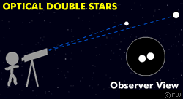

Slide 5
Eclipsing Binaries
Eclipsing binaries are a pair of stars that orbit each other. One will move in front and behind the other as seen from Earth.
Frequently one star is brighter than another and we can see the stars wink and dip as the darker star moves in front and behind it.
By charting the brightness of a binary star you can find its period. In the chart on the right the period would be from the 'dips' at 24 and 64 leading to a period of 30 hours.

Slide 6
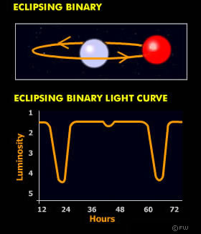
http://www.gcseastronomy.co.uk/space/animation/flash_starlight.html

Slide 7
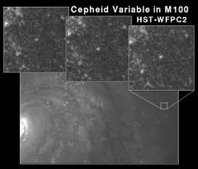
Cepheid Variables
Cepheid variable is a star that pulses frequently. We see the light they produce dip and rise over a short period of time, returning to the same luminosity a few days later.
Cepheids have a period-luminosity relation.
The longer the period between peaks of brightness the brighter the star is. From this we can figure out its apparent magnitude and from that how far away it is.
Cepheids in other galaxies enable us to accurately measure how far away that galaxy is, something we would not be able to do with heliocentric parallax because the angles are very small.

Slide 8
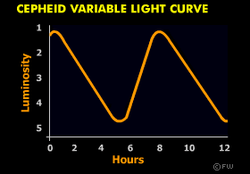

Slide 9
What are cepheid variables
Imagine the Universe Cepheid Variables as Cosmic Yardsticks

Slide 10
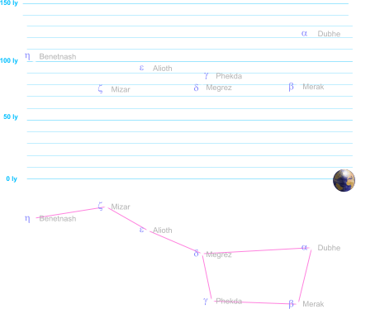
Distance between stars

Slide 11
Apply your knowledge
Stop frame animation! You are going to produce a stop frame animation of a binary star showing how it moves. You might want to red shift the star as it moves away, and blue shift it as it comes near (I would be very impressed if you succeed in this!)

Slide 12
Your Task
You have art straws. You need to make a 3D model of plough using a scale which will how the equivalent distances. You will have the previous picture on the board to help.
Star Name | Light Years Away
Mizar | 78
Megrez | 79
Merak | 80
Phekda | 85
Allioth | 90
Benetnash | 105
Dubhe | 125

