Slide 1
Groups of Galaxies

Slide 2
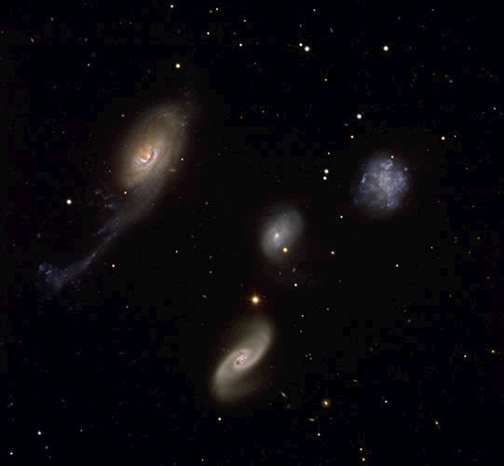
Roberts Quartet, what types of galaxy can you see here?

Slide 3
Answer
NGC 87 (upper right) is an irregular galaxy
NGC 88 (centre) is an elliptical galaxy
NGC 89 (lower middle) is a spiral galaxy with two large spiral arms. The largest member of the system,
NGC 92 (left) is an active galaxy with a very bright central nucleus

Slide 4
Lesson Objectives
To describe the Local Group of galaxies and to recall the names of some of its members.
To understand that galaxies are grouped on a larger scale in clusters and superclusters.

Slide 5
Our local group of galaxies
The Milky Way is actually converging with a smaller galaxy, the Sagittarius Dwarf galaxy. In several million years' time, the larger Andromeda galaxy (M31) will converge with the Milky Way and form a larger galaxy.
Some of these groups are grouped again. The Milky Way Group is part of a larger group again called a cluster. We are in the Virgo Supercluster.
We also have companion galaxies orbiting very close to the Milky Way in the form of Magellanic Clouds, after which was named after the explorer Magellan when he ventured into the Southern Hemisphere.
The nearest, the Large Magellanic Cloud orbits just 170,000 light years away from us.
The Small Magellanic Cloud is slightly further, while the Andromeda Galaxy, the largest galaxy in the Local Group is 2 million light years away. Other notable galaxies include the Triangulum Galaxy.
The Milky Way lies roughly in the middle of the Local Group.
You will need to know the names of the galaxies in our local group

Slide 6
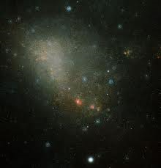
Small
Magellanic Cloud

Slide 7
Types of Clusters
Regular Clusters relatively compact, with a concentration of density towards the centre. Contains mostly ellipticalgalaxies. Many emit radio waves from active galaxies, as well as intergalactic gas. Some intergalactic gas is at temperature of 100 million degrees, emitting in X-rays.
Irregular Clusters Little central concentration. Mostly composed of spirals and irregulars. Fewer radio waves and X-rays, and less hot gas.
Superclusters Clusters of galaxies are grouped together into superclusters. These superclusters appear to form into 'sheets' of galaxies surrounding voids, giving a 'holy' effect.
The Great Wall is the largest supercluster known.

Slide 8
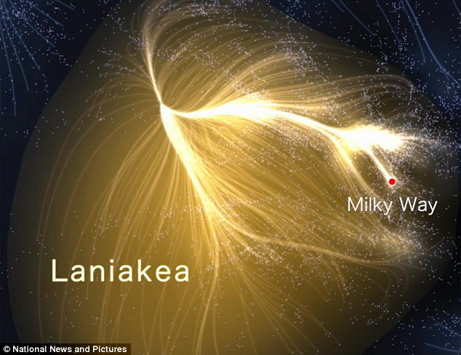

Slide 9
Apply Your Knowledge
Complete Galaxy Graphic Task

Slide 10
Review
What is the Local Group of galaxies?
Name some galaxies in the Local Group?
What kinds of groups have been observed?

