Slide 1
Magnitudes
This is hard!!!

Slide 2
Lesson Objectives
To relate the apparent magnitude scale to the brightness of stars.
To perform simple calculations relating magnitude differences to brightness ratios.
To distinguish between apparent magnitude and absolute magnitude

Slide 3
What is Magnitude?
We measure the brightness of a star by its magnitude. There are two types of magnitude:
Apparent magnitude is how bright an object is to us on Earth.
Absolute magnitude is how bright a star would appear in space from a certain distance.
http://www.gcseastronomy.co.uk/space/animation/flash_magnitude.html

Slide 4
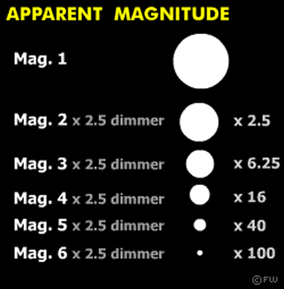
Apparent Magnitude
Hipparchus, a Greek astronomer, devised a method of measuring the brightness of stars.
A bright star would be said to have an apparent magnitude of 1. A faint star has an apparent magnitude of 6.
A few stars, planets and of course our own Sun have been recategorised so they appear brighter than 1. Sirius appears at -1, Venus at -4, a full Moon at -9 and the Sun at -29.
http://www.youtube.com/watch?v=9P8Veb_AlJ0
http://www.youtube.com/watch?v=Bcz4vGvoxQA

Slide 5
Absolute Magnitude
Absolute magnitude is a useful way of finding out how bright a star would appear from a certain point in space. By doing this we understand each star's true magnitude.
The true absolute magnitude for the Sun is 4.2 whereas to us on Earth it is -27.
It is the brightness of a star at a distance of 10 parsecs which is 32.6 light years.
A log function is how many 0s you have on a number. For example, the logarithm of 1000 to base 10 is 3, because 1000 is 10 to the power 3: 1000 = 10 × 10 × 10 = 10³

Slide 6
Calculations
m = Apparent magniture
M = Absolute magnitude
There are different types of calculation you will be asked to make. Working out differences in apparent magnification, finding absolute and apparent magnification and also distance.
To work out Absolute Magnitude:
M = m + 5 - 5 log d
To work out Apparent Magnitude:
m = M-5+5 log d
To work out Distance using Magnitude:
D = 10(m-M+5)/5

Slide 7
Example 1
Spica has an apparent magnitude of 0.98 and an absolute magnitude of - 3.55. Which is brighter when viewed from a distance of 10 parsecs?

Slide 8
Solution
10 parsecs is the brightness measured at absolute magnitude. A smaller (or even negative) number is brighter. Spica's absolute magnitude is therefore brighter

Slide 9
Example 2
Star A is apparent magnitude 2.3. It is 2.5 times brighter than B. What is B's apparent magnitude?

Slide 10
Answer
2.5 brighter = 1 magnitude
B = 3.3

Slide 11
Example 3
Two stars, A and B have different apparent magnitudes: A= 1.8, B = 4.8
a) How many degrees of apparent magnitude is A brighter than B?
b) How much brighter is A than B

Slide 12
Answer
M = m + 5 - 5 log d
M = 0.15 + 5 -5 log 238
M = -6.73
Two stars, A and B have different apparent magnitudes: A= 1.8, B = 4.8
a) How many degrees of apparent magnitude is A brighter than B?
b) How much brighter is A than B

Slide 13
Example 4
The star, Regelus has an absolute magnitude of 0.54. It is 23.8 parsecs from Earth. What is its apparent magnitude from Earth?

Slide 14
Answer
m = M-5+5 log d
m = 0.54 -5 + 5 log 23.8
m = 2.42

Slide 15
Apply your Knowledge
Try exam style questions on distance and magnitudes.

