Slide 1
Milky Way

Slide 2
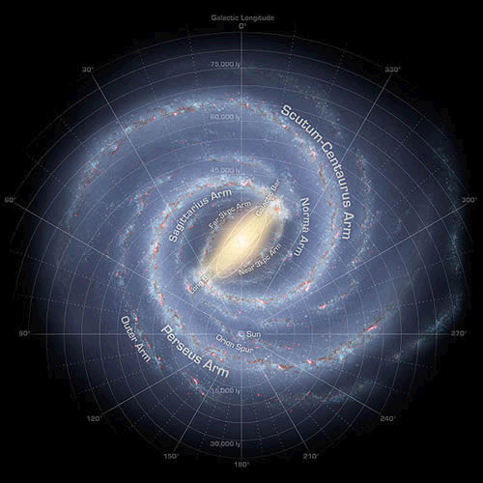
Image taken using radiowaves, why can’t we use visible light?
Approx diameter of the milky way is 30KPc!

Slide 3
Lesson Objectives
To describe the appearance of the Milky Way in the night sky: (i) with the naked eye, (ii) with the aid of binoculars, and (iii) through a small telescope.
To show an awareness that the observed Milky Way is the plane of our Galaxy.
To understand the shape and size of our Galaxy.
To understand how astronomers use radio waves to determine the structure and rotation of our Galaxy.

Slide 4
What is the Milky Way?
The Milky Way is named because it looks like a path in space that looks 'Milky'.
With the naked eye it looks like a furry light irregular column in the sky. We only see this bright long area; we don't make out any stars we could see with binoculars. With binoculars, the Milky Way’s haziness is cleared a little and we can make out small stars.
With a telescope we can see that the Milky Way comprises of countless stars which we can see clearly. Sweeping along the Milky Way this continues; if we move the telescope away a little, we will see less stars than in the Milky Way plane.
What we see of the Milky Way is actually the plane of our own galaxy.

Slide 5
Animation
http://www.gcseastronomy.co.uk/space/animation/flash_milkyway.html

Slide 6
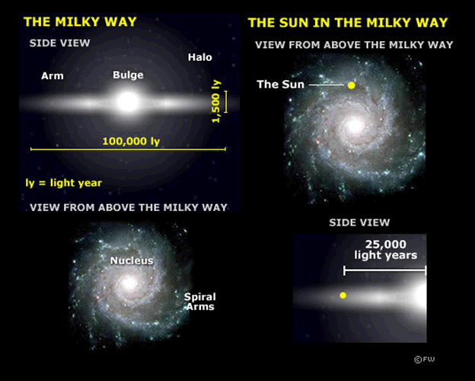
Shape and Size of the Milky Way
Old stars are in the centre of the Milky Way
Young stars and dust is around the edge, why is this?

Slide 7
Rotation
It is more accurate to study the rotation of our galaxy by radio waves because we can only see part of the sky with visible light.
The Sun is around 30,000 light years from the centre of the Milky Way. This is about two-thirds of the way from the centre, along one of the spiral arms.
Like the planets orbiting the Sun, the Sun in turn orbits the centre of the Milky Way along a spiral arm.
It takes 226 million years to make a galactic orbit.
The Sun is positioned on a spiral arm called the Orion Arm.

Slide 8
Construct your knowledge
On an A3 sheet of paper construct a detailed diagram of our milky way containing all appropriate labels.

Slide 9
Apply Your knowledge
Complete the exam style question

Slide 10
Use a green pen ☺

Slide 12
http://www.youtube.com/watch?v=aNV1Q--R7-A

