Slide 1
Observing the Sun
http://www.youtube.com/watch?v=sGuZ-9M5FeM

Slide 2
Learning Outcomes
To appreciate how astronomers make observations of the Sun at different wavelengths of the electromagnetic spectrum.
To describe the appearance of the Sun at different wavelengths

Slide 3
Wavelengths
To appreciate how astronomers make observations of the Sun at different wavelengths of the electromagnetic spectrum
Humans see visible light. This is just one part of the electromagnetic spectrum. The Sun emits light in frequencies across this spectrum. By using instruments that operate in these frequencies scientists can study the Sun and its behaviour.
Without these observations it would be difficult to study sunspots in great detail, flares or even the surface of the Sun with accuracy.
As well as infrared, ultraviolet, x-ray observations, usually conducted at high altitude or in space, other less well known wavelengths exist.

Slide 4
H Alpha
H-Alpha is a specific wavelength in the visible part of the spectrum. It allows astronomers to study the Sun's surface as well as nebulae. Optical filters are attached to a telescope (by experienced astronomers) allowing the observer to study the Sun. Calcium-K is a similar filter. This allows us to observe on wavelengths that operate only on these frequencies.

Slide 5
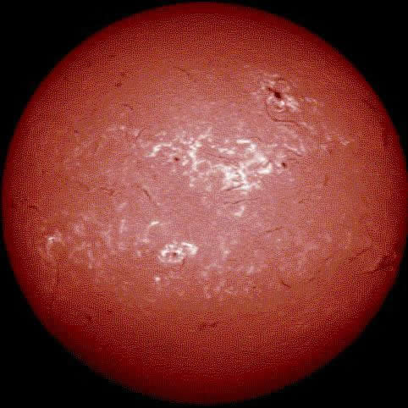
H Alpha

Slide 6
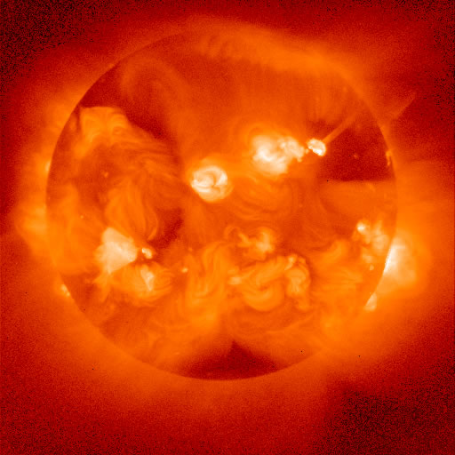
X ray

Slide 7
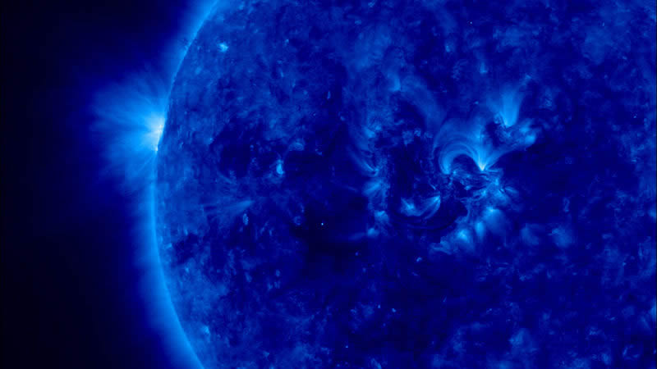
Extreme Ultra Violet

Slide 8
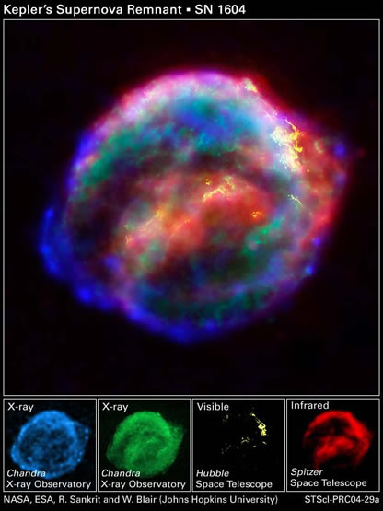

Slide 9
Apply your Knowledge
To describe the appearance of the Sun at different wavelengths
Using the sheet provided, draw a picture, and describe how the sun looks at different wavelengths.

Slide 10
Review

