Slide 1
Bell Work
This is one popular mnemonic for remembering the order of the planets.
Write down your own on the post-it note. When you’ve done this, stick it on the board.

Slide 2
Orbits

Slide 3
Learning Outcomes
• To know that planets etc. move in elliptical orbits around the Sun.
• To understand named terminology with respect to planetary orbits.
• To be able to identify and explain the apparent motion of the Sun and planets on a star chart, and appreciate the most favourable points at which planets can be observed.

Slide 4
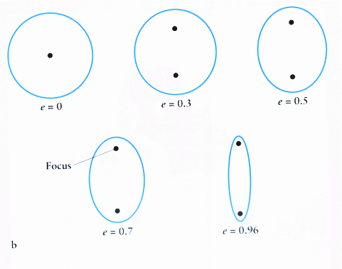
Planets orbit in an ellipse. This is like a squashed circle.
A
circle
http://www.gcseastronomy.co.uk/space/animation/anim_solarsystem.html

Slide 5
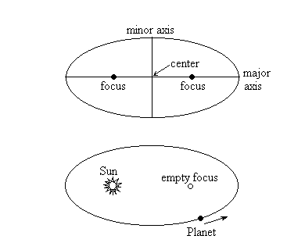
An ellipse has two foci (focuses). In the case of the planets, the ellipse is only slightly squashed and the sun is at one of the foci.
This diagram is exaggerated but it’s important to remember that the sun is not at the centre, but at one focus.

Slide 6
Learning Outcomes
• To know that planets etc. move in elliptical orbits around the Sun.
• To understand named terminology with respect to planetary orbits.
• To be able to identify and explain the apparent motion of the Sun and planets on a star chart, and appreciate the most favourable points at which planets can be observed.

Slide 7
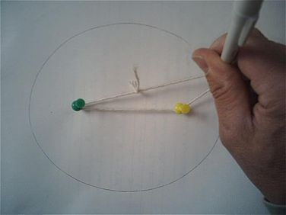
Drawing your own ellipse.
https://www.youtube.com/watch?v=7UD8hOs-vaI

Slide 8
1. On your diagram, label the one focus as the sun.
Add the following labels: aphelion, perihelion, major axis, minor axis.
You may need to use the internet to research some of these terms.
2. Freehand draw three ellipse around the sun on a separate diagram to show the orbits of Venus, Earth and Mars.
Label the positions of:
greatest elongation,
conjunction,
opposition,
transit
and occultation

Slide 9
Opposition - In positional astronomy, two celestial bodies are said to be in opposition when they are on opposite sides of the sky, viewed from a given place (usually the Earth).
Perihelon – When the planet is at the closest to the sun.
Aphelion – The point in its orbit when a planet or comet is at its greatest distance from the sun
Occulation - An occultation is an event that occurs when one object is hidden by another object that passes between it and the observer
Conjunction – When 2 objects have the same longitude

Slide 10
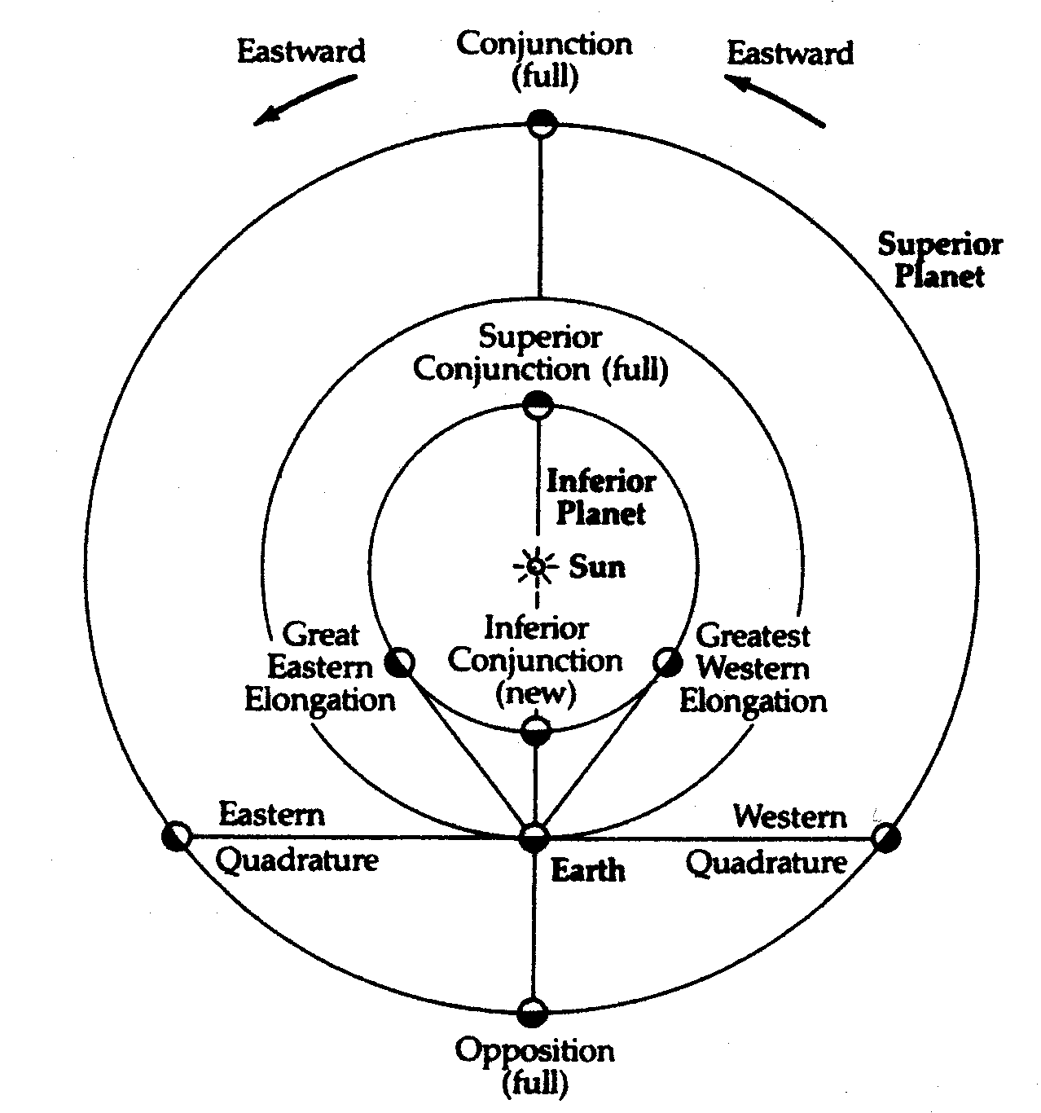

Slide 11
Planets orbit in:
Red: Circles
Orange: Ovals
Green: Ellipses
Green: Ellipses

Slide 12
The sun is at the ________ of the orbit.
Red: Centre
Orange: Focus
Green: Edge
Orange: Focus

Slide 13
The planet is closest to the sun at...
Red: Aphelion
Orange: Perihelion
Green: Elongation
Orange: Perihelion

Slide 14
The planet X in the diagram is at:
Red: Opposition
Orange: Superior Conjunction
Green: Inferior Conjunction
Earth
Red: Opposition

Slide 15
Where do you think it’s best to observe the planets.

Slide 16
Learning Outcomes
• To know that planets etc. move in elliptical orbits around the Sun.
• To understand named terminology with respect to planetary orbits.
• To be able to identify and explain the apparent motion of the Sun and planets on a star chart, and appreciate the most favourable points at which planets can be observed.

Slide 17
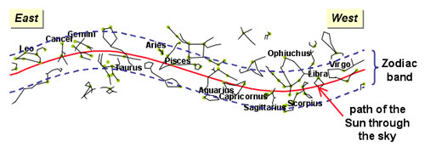
The Zodiac and The Ecliptic
The ecliptic is the line that the sun traces across the sky throughout the year. Because the Earth is tilted at a slight angle, the line isn’t straight. It rises up to its peak in summer then falls in winter.

Slide 18
The Zodiac is a band that follows the ecliptic. Because the planets orbit in the same plane as the Earth, the planets can always be found somewhere along the zodiac.

Slide 19
Learning Outcomes
• To know that planets etc. move in elliptical orbits around the Sun.
• To understand named terminology with respect to planetary orbits.
• To be able to identify and explain the apparent motion of the Sun and planets on a star chart, and appreciate the most favourable points at which planets can be observed.

Slide 20
Homework:
Write a report explaining what the atmosphere on Venus is like. It should explain what the atmosphere is made off, how hot it is, and what physical processes are happening.

