Slide 1
Origin of the Moon

Slide 2
Learning Outcomes
To explain why the Giant Impact Hypothesis is the most likely theory of the origin of the Moon.
To describe some of the scientific evidence for the likely origin of the Moon.

Slide 3
Theories of the Moon
There are four theories about how the Moon originated:
The Moon evolved in a different part of the Solar System and was captured by Earth's gravity
It formed in the same part of the Solar System near the Earth
The Earth spun rapidly during its early evolution and Earth material flung out to form the Moon.
A Mars size object crashed into the early Earth, changing its axis and jettisoning debris into its orbit and the Moon formed from this. (The Giant Impact Hypothesis)

Slide 4
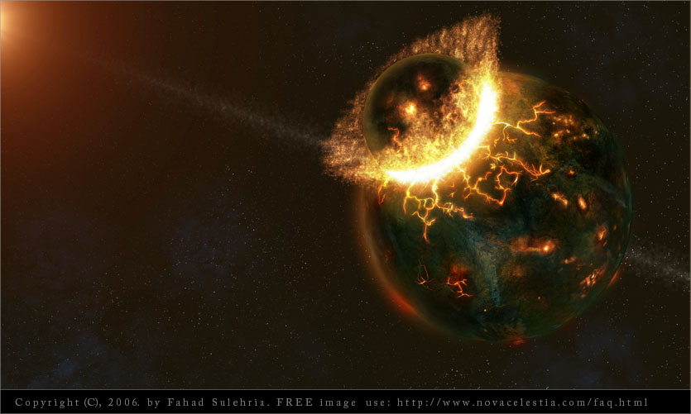
The Giant Impact Hypothesis
Explain why the Giant Impact Hypothesis is the most likely theory of the origin of the Moon.
Analysis of rock from the Apollo landings confirm the Moon is made of similar material and rock as the Earth from about the same time.
Another reason for the theory is because scientists believe the Moon's crust was molten and an impact would have provided this.

Slide 5
Apply Your Knowledge
To describe some of the scientific evidence for the likely origin of the Moon.
Produce an information booklet about the different origins of the moon. Include some of the scientific evidence of each, paying particular attention to the giant impact hypothesis.

Slide 6
Review

