Slide 1
Sunspots

Slide 2
Learning Outcomes
To demonstrate an understanding of the nature and cause of sunspots.
To understand how observations of sunspots allow astronomers to study the Sun’s rotation.

Slide 3
What are Sunspots
To demonstrate an understanding of the nature and cause of sunspots.
Sunspots are areas on the photosphere of the Sun that are cooler than the surrounding area and so appear darker.

Slide 4
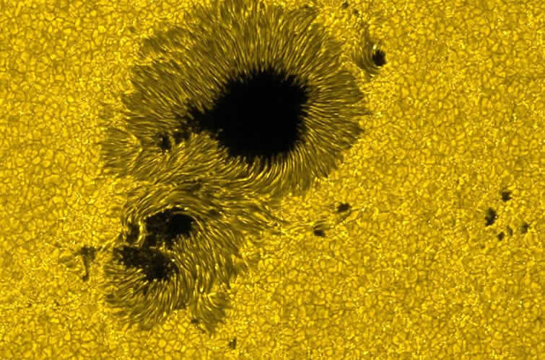
Penumbra
Umbra
Temperatures of the umbra are typicaly 4,000k. The penumbra is usually around 5,600k.

Slide 5
How are sunspots caused?
Sunspots are caused by local changes in the Sun's magnetic field. When this field is stronger in one region, the convention abilities (the way heat rises) are diminished and so the hotter gases from below do not affect that region temporarily. Their duration may vary from several hours to months.

Slide 6
Sunspot Documentary
To understand how observations of sunspots allow astronomers to study the Sun’s rotation.
Watch the documentary and make notes about relevant points.
http://www.youtube.com/watch?v=wisdfag6WIQ

Slide 7
Review
Why does a sunspot look darker than the rest of the Sun?
Describe the long term drift of sunspots.
Describe the sunspot Cycle

