Slide 1
The Solar System
http://www.youtube.com/watch?v=dxEekUy0Ehk

Slide 2
Lesson Objectives
• To appreciate the scale and size of our Solar System, with reference to models on a variety of scales.
• To distinguish between planets, dwarf planets, asteroids, comets and TNOs.

Slide 3
What does our solar system contain?
Objects in the Solar System orbit a central star, our Sun. The largest bodies are known as planets and officially there are 8 of them.
New type of objects have been defined in the last few years - dwarf planets. Typically these are smaller and have certain orbits to distinguish them from planets.
Other objects are like dwarf planets and move in an orbit past Neptune. These are called Trans-Neptunian Objects (TNOs).
http://www.gcseastronomy.co.uk/space/animation/anim_solarsystem.html

Slide 4
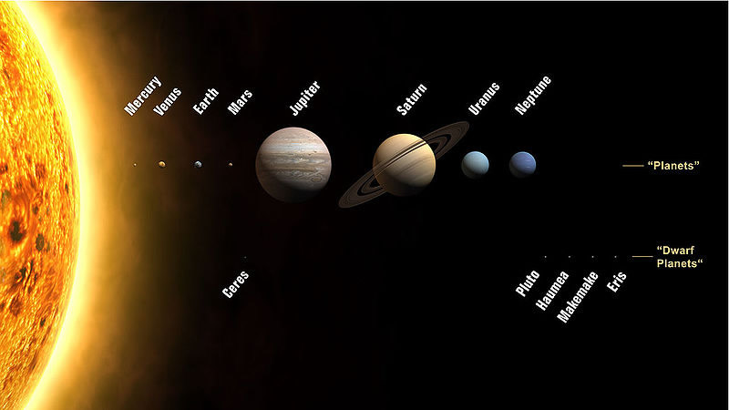
http://www.youtube.com/watch?v=x1w8hKTJ2Co

Slide 5
Your task
Between you, you need to produce a wall display on the planets. You may want to split the planets up so that each person does a planet and then put your work together. It is up to you to plan and organise what you are going to do and how you are going to do it.

