Slide 1
Variable Stars

Slide 2
Lesson Objectives
To identify Cepheid variable and binary stars from their light curves.
To explain how Cepheid variables can be used to determine stellar distances.
To explain the light curve of a binary star in terms of a primary and secondary star in common orbit

Slide 3
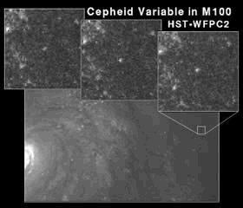
Cepheid Variable
A Cepheid variable is a star that pulses frequently. We see the light they produce dip and rise over a short period of time, returning to the same luminosity a few days later.
http://www.youtube.com/watch?v=caYeTinG2GM

Slide 4
How are they useful?
Cepheid's have a period-luminosity relation. The longer the period between peaks of brightness the brighter the star is.
From this we can figure out its apparent magnitude and from that how far away it is. Cepheid's in other galaxies enable us to accurately measure how far away that galaxy is, something we would not be able to do with heliocentric parallax because the angles are very small.

Slide 5
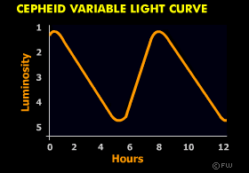
Cepheid Light Curves
http://www.gcseastronomy.co.uk/space/animation/flash_starlight.html

Slide 6
Construct your Knowledge
Produce a piece of work outlining how Cepheid variables can be used to measure distances. Use diagrams to help.

