Slide 1
Water on Earth

Slide 2
Bell Work (exam question)
Recently, astronomers have discovered that many stars possess systems of planets
(exoplanets).
(i) Describe two methods that astronomers use to detect the presence of exoplanets.
ii) Explain why astronomers find it difficult to detect individual planets.

Slide 3
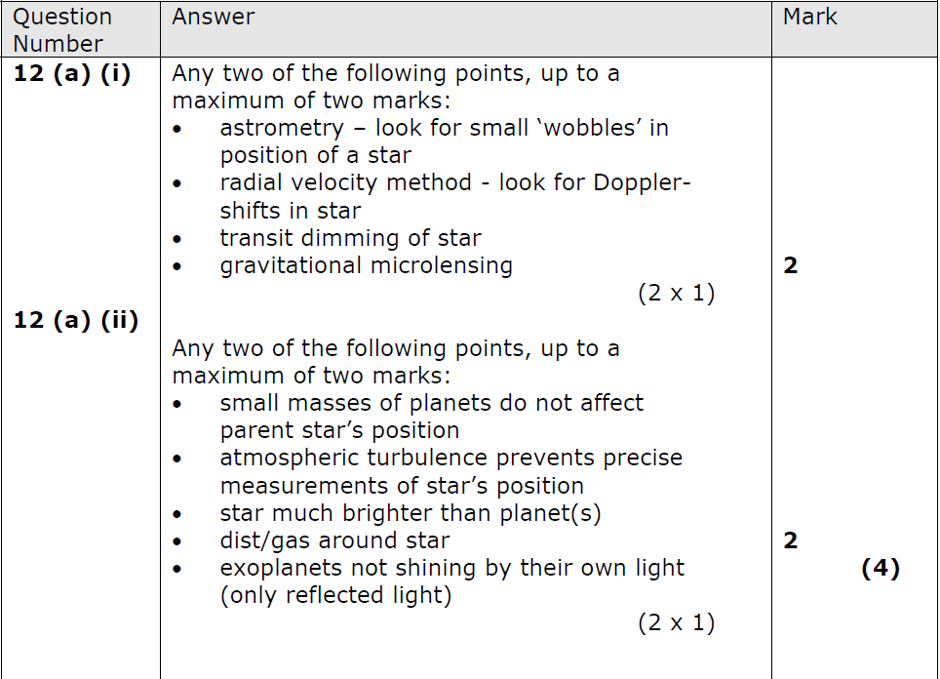

Slide 4
Lesson Objectives
To understand the significance of water as a requirement for life.
To describe some of the current theories about the origin of water on Earth.
To describe methods that astronomers and space scientists use to determine the likely origin of water on Earth.

Slide 5
Why is water important?
To understand the significance of water as a requirement for life.
Water is needed for life to exist. It is considered to have been crucial to forming life due to its properties' as a solvent allowing various chemicals to form.
Water is formed by star formation. Hydrogen and Oxygen are common throughout the Universe and these group to form water
There are 2 main theories about where water on earth came from

Slide 6
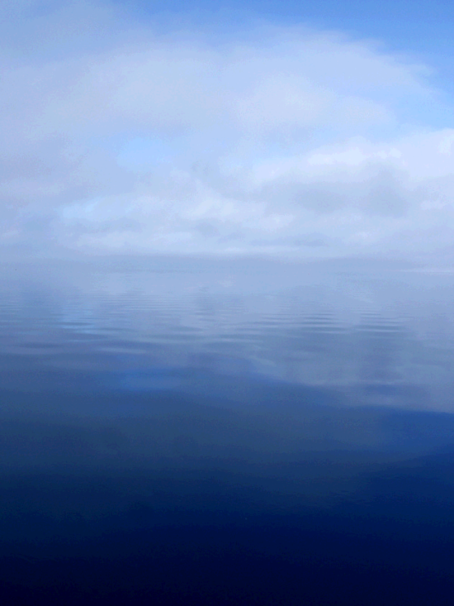
Condensation Theory
To describe some of the current theories about the origin of water on Earth.
This theory says that water was part of Earth’s body when it formed. As the Earth cooled, water leaked from rocks and the atmosphere condensed the water into liquid form.

Slide 7
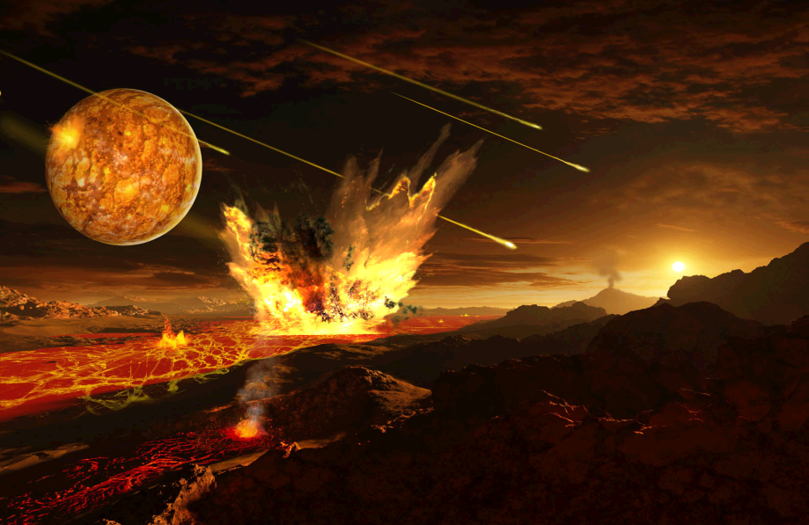
Delivery by Comets
It is thought that Earth was heavily bombarded by comets and other bodies early in its evolution and the Moon bears evidence of this.
Comets contain large amounts of ice and this would have fed our oceans on impact.

Slide 8
http://www.youtube.com/watch?v=_LpgBvEPozk

Slide 9
Where is water currently?
So far water ice has been detected on the Moon, Mars, Titan, Europa, Saturn's rings, Enceladus, Pluto and Charon. Traces of water have been found in the clouds of Venus and Jupiter. Water also exists in the exosphere (the outmost part of its extremely faint atmosphere) of Mercury

Slide 10
Construct Your Knowledge
To describe methods that astronomers and space scientists use to determine the likely origin of water on Earth
Research current and planned space missions to detect and analyse water on asteroids and comets. We will be sharing what we find our afterwards

